Slide 1


BANK LOAN DATA
VARSHA R
23BDS046

Slide 2

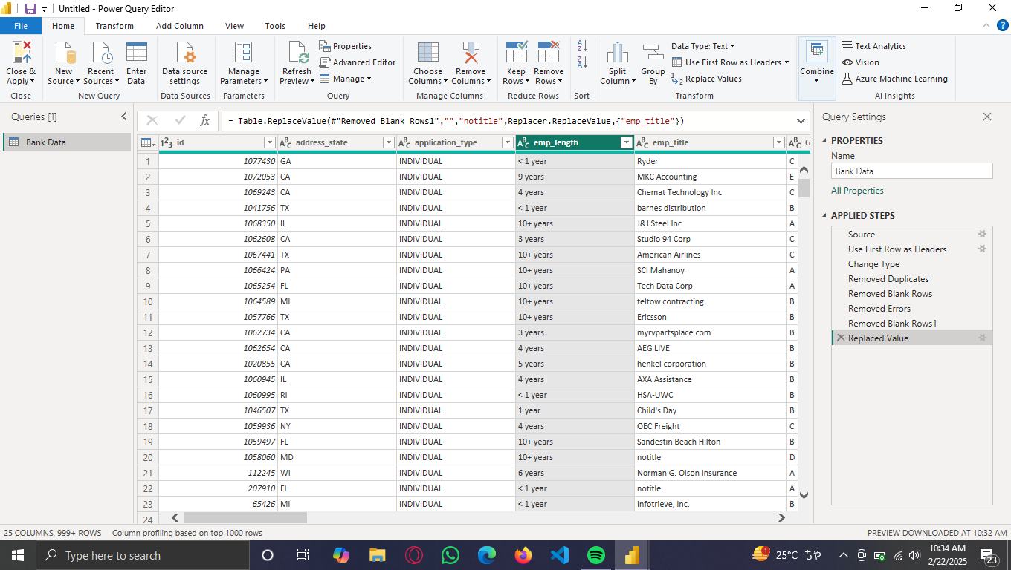
TRANSFORM DATA

Slide 3
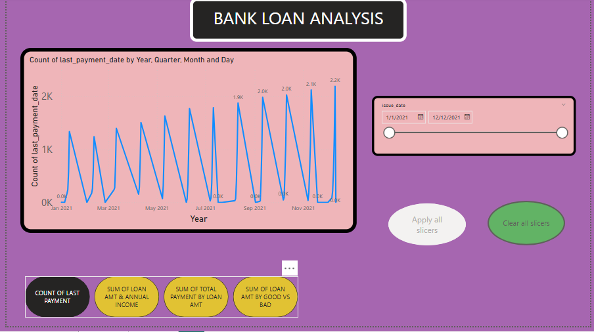
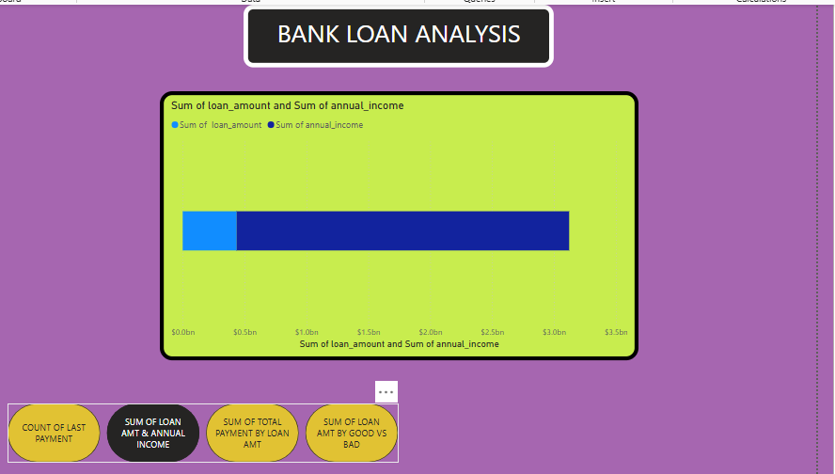
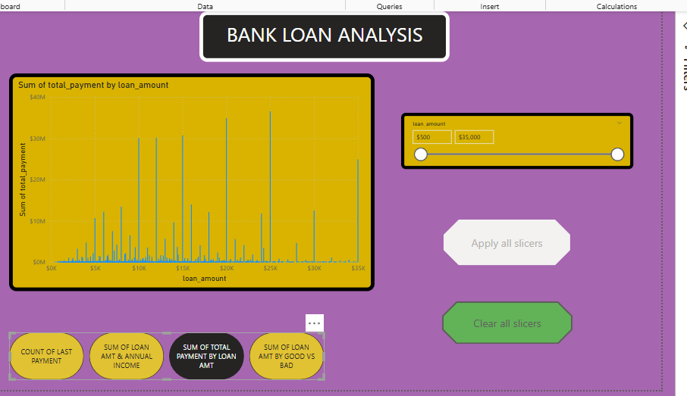
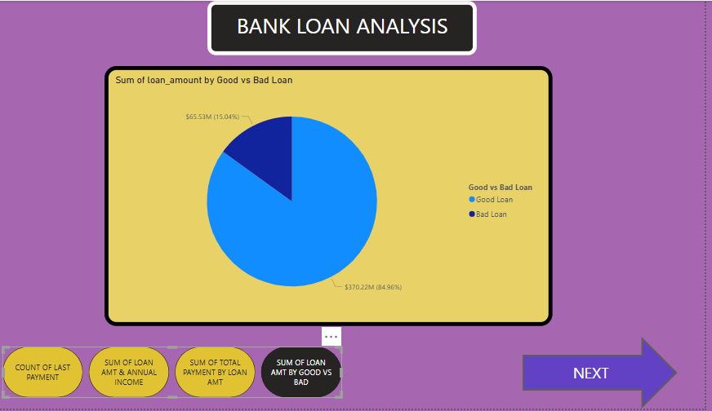
VISUALIZATION

Slide 4
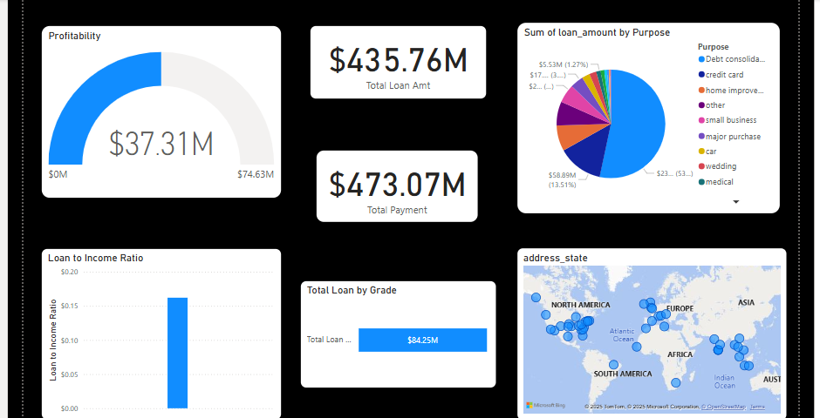

Slide 5

INSIGHTS
Loan Distribution by Grade → Higher-grade loans (A, B) have lower interest rates, while lower-grade loans (D, E, F) have higher rates.
Interest Rate vs. Loan Amount → Larger loan amounts tend to have higher interest rates, especially for lower credit grades.
Default Rate by Employment Length → Borrowers with less than 2 years of employment have a higher default rate than those with longer job history.
Home Ownership Impact on Loan Defaults → Borrowers who rent have a higher default rate than those who own or have a mortgage.
Loan Performance by State → Certain states (e.g., California, Texas) have higher loan issuance and default rates.

Slide 6
THANK YOU

